Slide 1
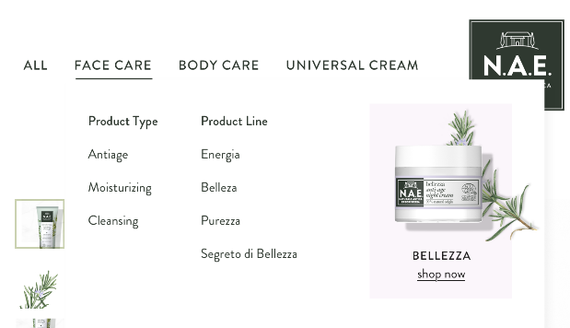
FACE CARE
Moisturizing / Energia:
Day Cream
Night Cream
Soothing Cream
Cleansing / Purezza:
Cleansing Gel
Cleansing Foam
Cleansing Milk
Micellar Water
Tonic Lotion
OUR LINES
Anti-age
Moisturizing
Cleansing
PRODUCTS
Day cream
Night cream
Fluid Serum

Slide 2
BODY CARE
OUR LINES
Refreshing
Moisturizing
Revitalizing
Fragrance-free
PRODUCTS
Body Balm
Shower Gel
Liquid Hand Soaps
Deodorant

